Slide 1

Weather Analysis

Slide 2
Topics
Mean Temperature
Wind Speed
Weather conditions
Maximum
Temperature
Precipitation

Slide 3
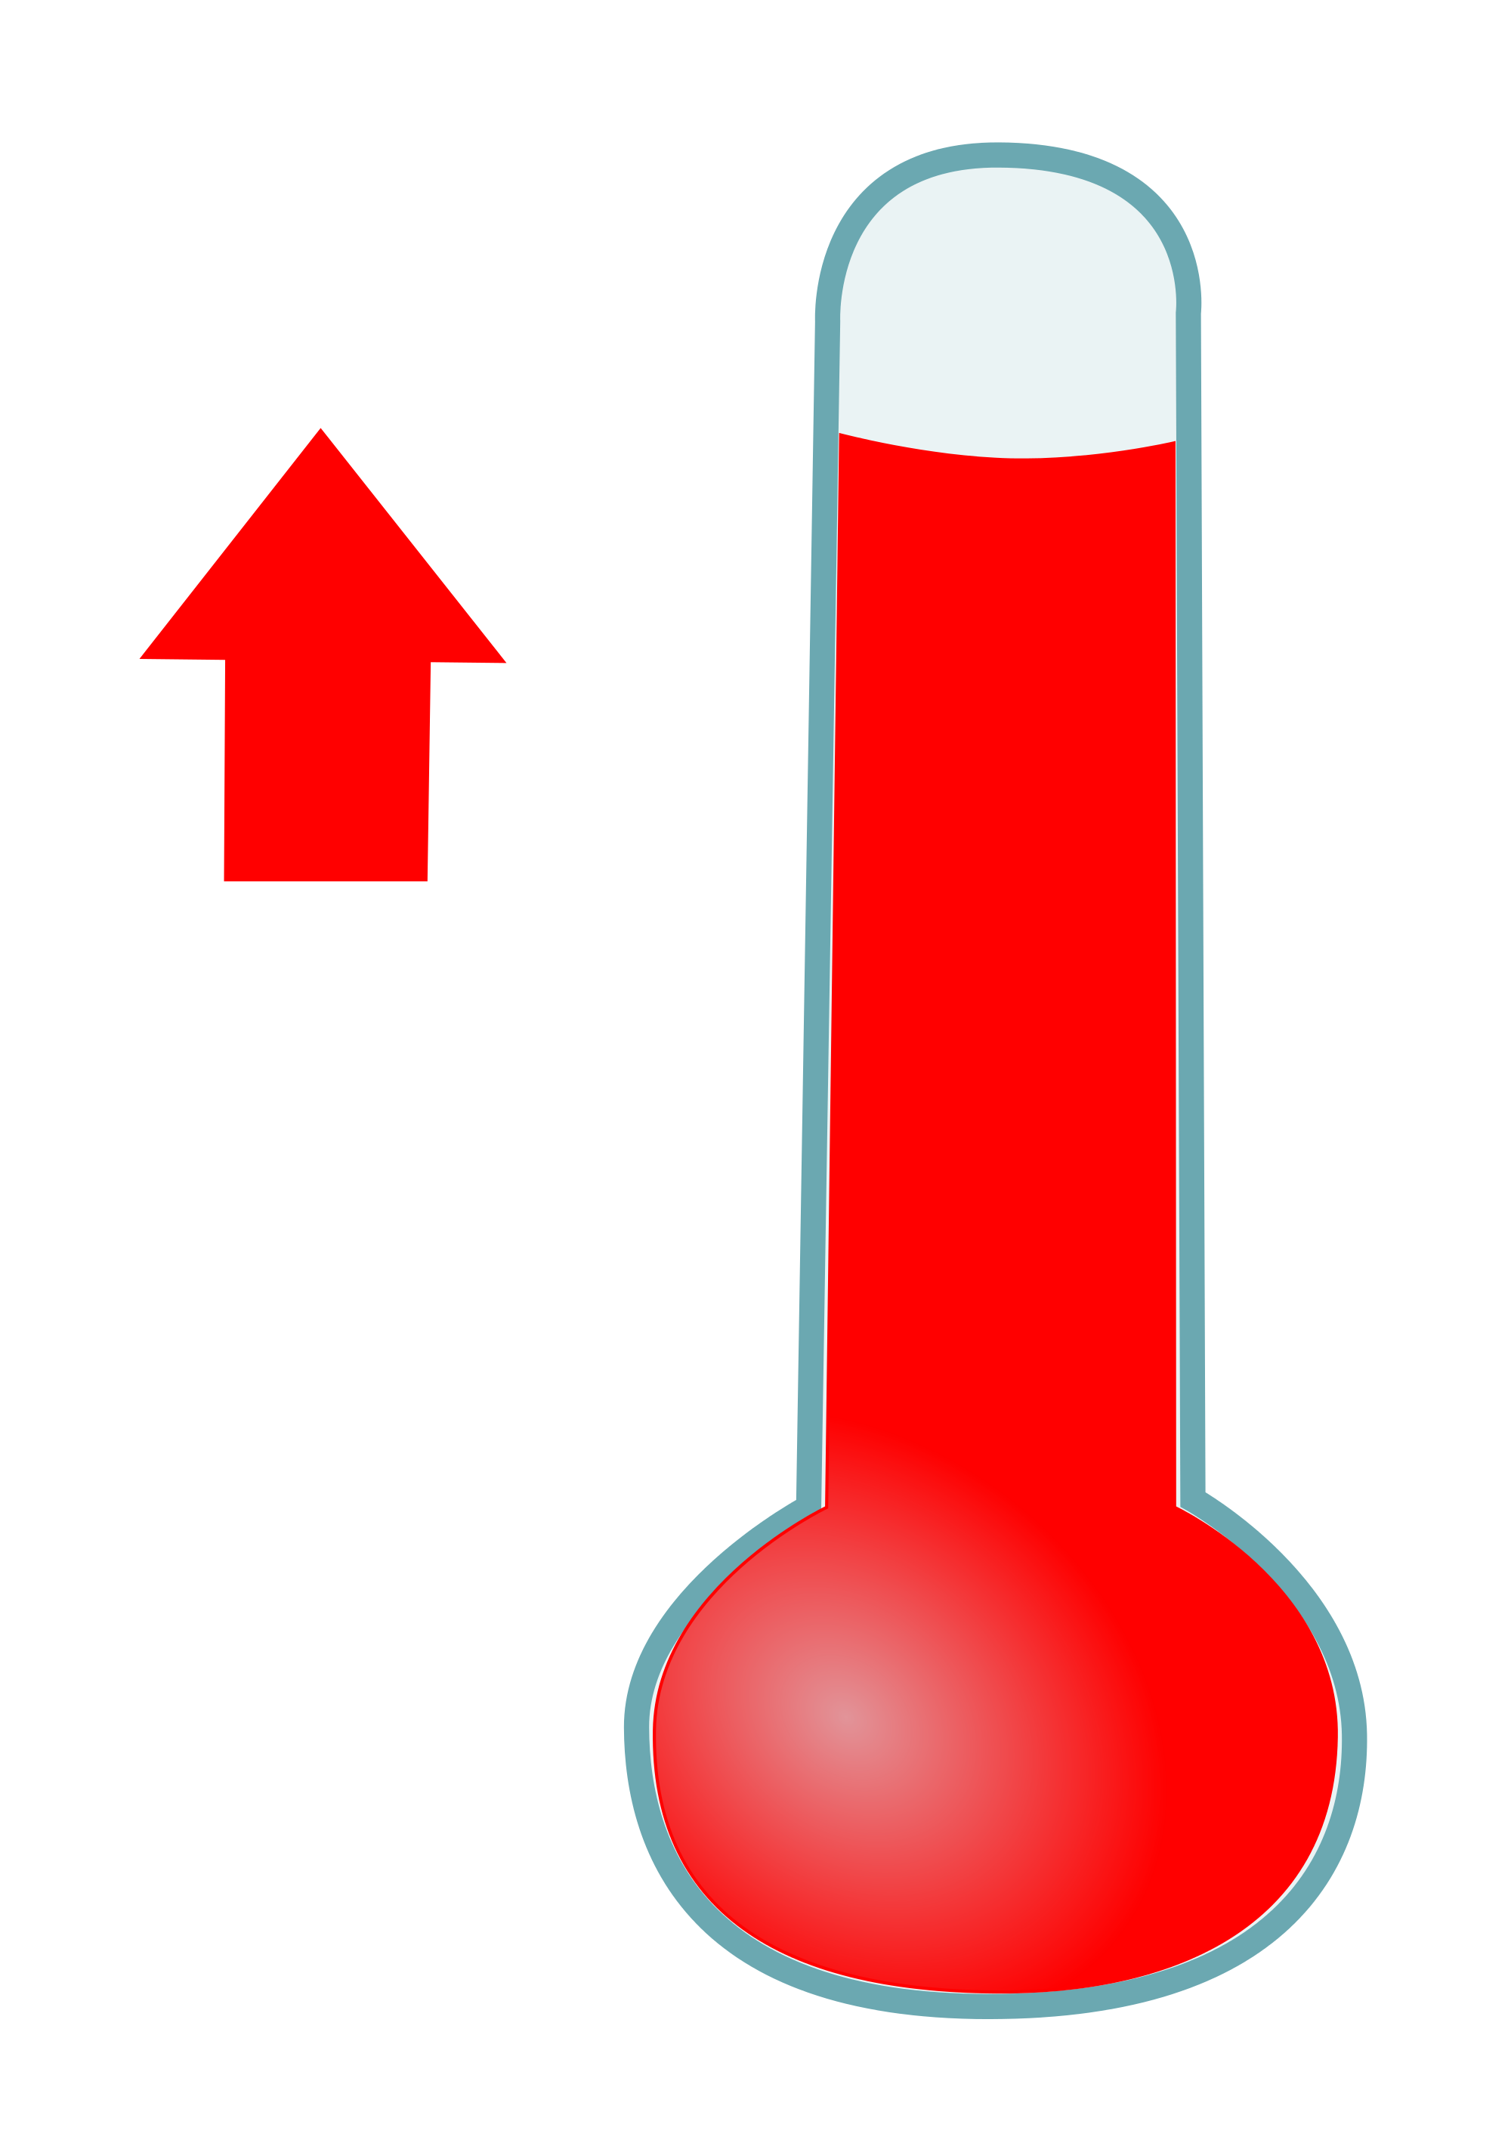
Maximum TEMPERATURE
This Photo by Unknown Author is licensed under CC BY-NC

Slide 4
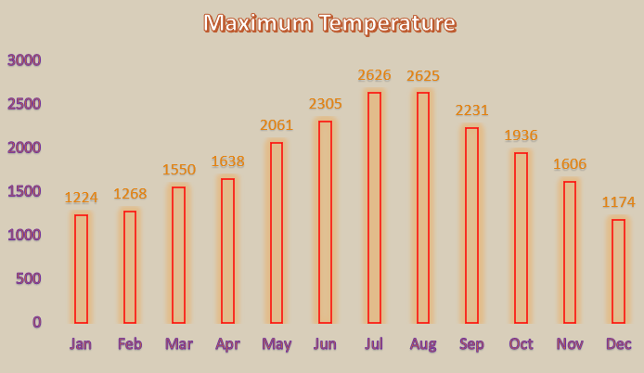
Maximum temperature
The temperature which attains peak temperature with reference to throughout the year is called maximum temperature.
In accordance with data analysis, the maximum temperature achieved was in the month of July.
The temperature is linearly increasing throughout the half year as can be analyzed from the column chart.

Slide 5
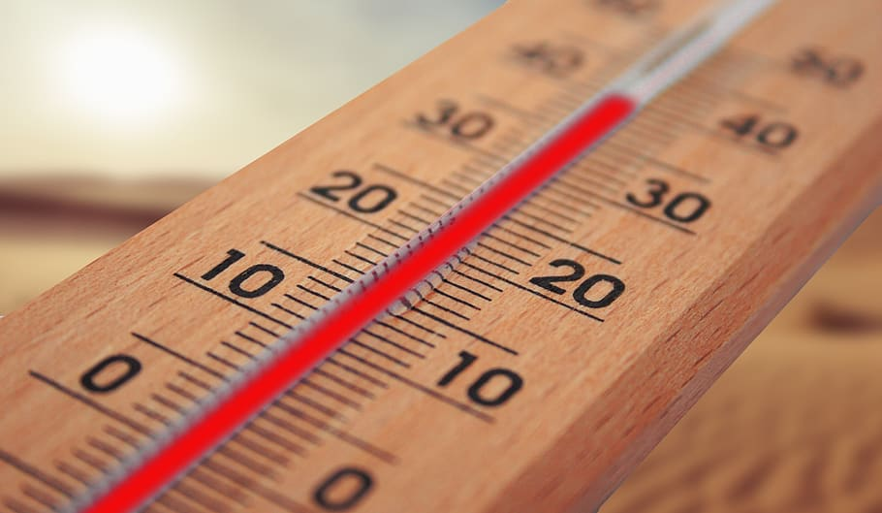
Mean Temperature

Slide 6
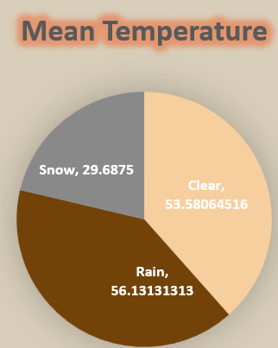
Mean temperature
The average of maximum and minimum temperature is called as mean temperature.
The formula for Mean temperature can be derived as follows:
Mean temperature = (Max temperature + Min temperature)/2
As can be observed from pie chart, the mean temperature in rainy season covers highest portion as compared to other seasons.

Slide 7
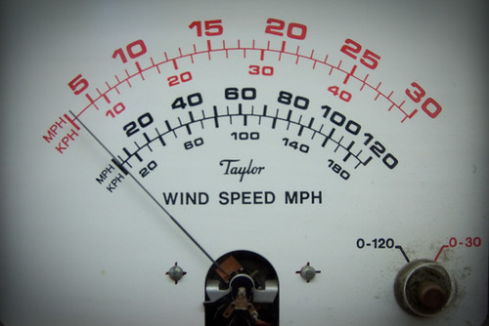
Wind Speed
This Photo by Unknown Author is licensed under CC BY

Slide 8
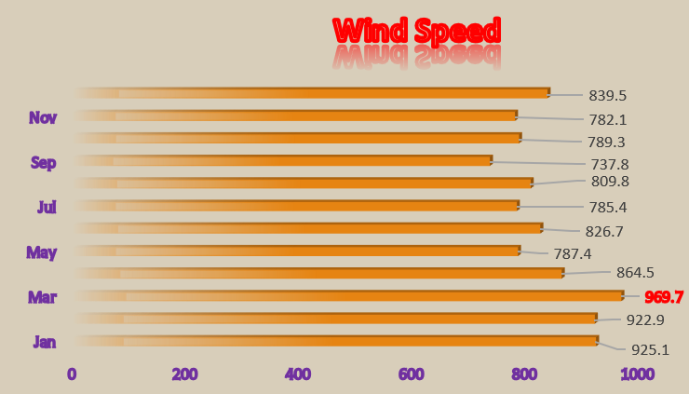
Wind SPEED
Wind speed describes how fast the air is moving past a certain point.
This may be an averaged over a given unit of time, such as miles per hour, or an instantaneous speed, which is reported to as peak wind speed.
As can be analyzed from the dashboard in bar chart, the maximum wind speed occurred in the month of march and was 969.7 MPH.

Slide 9
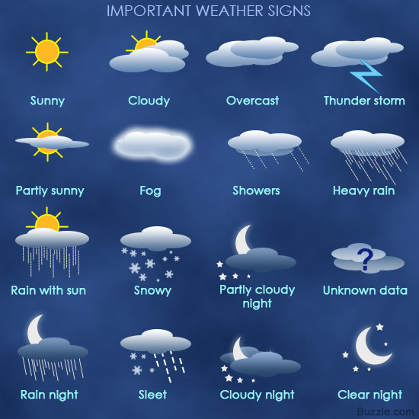
Weather conditions
This Photo by Unknown Author is licensed under CC BY-SA-NC

Slide 10
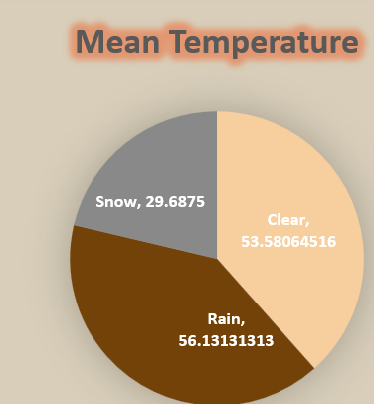
Weather conditions
As can be observed from Pie chart, clear, rain and snow climate exists throughout the year.
The maximum climate portion covered is rainy season and average mean temperature observed is 56.13 F.
The weather conditions are not constant every year and keeps changing according to environment conditions.

Slide 11
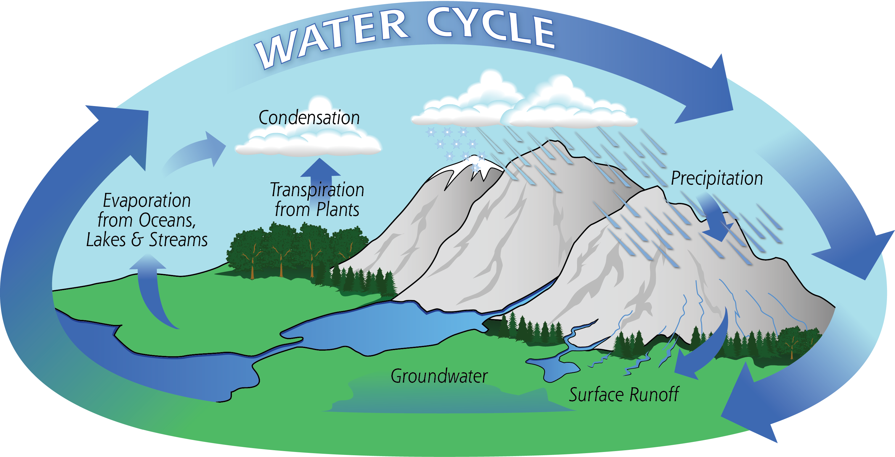
precipitation
This Photo by Unknown Author is licensed under CC BY

Slide 12
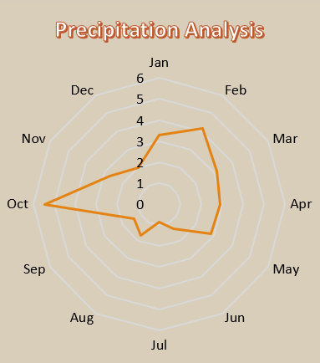
Precipitation
Precipitation is any liquid or frozen water that forms in the atmosphere and falls back to the earth.
Along with evaporation and condensation, precipitation is one of the three major parts of the global water cycle.
As can be analysed from radar chart, precipitation level is highest in the month of October.

Slide 13


